Slide 1
WPD Data Management App
Team:We Can Do It
Dhari, Abdulrahman, Elina, and Andrew
Notes:
Hello, everyone! We are the We Can Do It team and the project our team is working on for Senior Design is a data management application for the Wichita Police Department.
*Participation Time of each Presenter (roughly equal) (10%)*
*Presentation Clarity (simple language, easy to follow narrative) (20%)*
*Presentation Delivery (eye contact, gestures, practiced) (20%)*

Slide 2
About We Can Do It
Dhari (CE) - Team Lead
Mobile / Backend Development
Abdulrahman (EE) - Project Manager
UI/UX
Elina (CS) - Scribe
Database Development
Andrew (CS) - Team Facilitator
Front end Development
Notes:
A little bit about our team before we get started… -INTRODUCE YOURSELF- “Hello, my name is ____ and I am majoring in ____. I am the ____ and will be working on the _____”
*Identifies Team Members, Team Structure, Disciplines, and Roles (10%)*
*Personal Contributions Identified (and purpose of activity) (20%)*

Slide 3
Project Description
The Problem:
The WPD was having a problem with organizing and keeping track of their paper work with citizens.
The Solution:
To help them to make a process that Policemen and citizens can use through their phones.
Notes:
As mentioned earlier, we are working on a data management app for the Wichita Police Department. The issue at hand is that whenever the WPD is assisting or interacting with victims or citizens, they have resources that they need to give these citizens depending on what kind of case they are currently working on. Because there are so many different kinds of cases such as traffic incidents or theft, there is never a guarantee that the office on the case will have the enough paperwork available that day. And it is very common for people to lose track of papers that are given to them. As a way to combat this issue, the WPD thought of an idea to create a digitized way to still communicate these resources and information to the citizens, but without the complications of paperwork, using their phones. In today’s day and age, everyone has a mobile phone and when information is stored digitally, it is a lot easier to keep track of. This also eliminates the risk of officers not having enough of one pamphlet or paper during a time of need.

Slide 4
Requirements
UI / UX Requirements
Mobile Requirements
Front End Requirements
Operational Requirements
Notes:
*Content Clarity of Presentation Material (organized, summarizes findings) (20%)*

Slide 5

What are the UI / UX?

Slide 6

WireFrame design

Slide 7
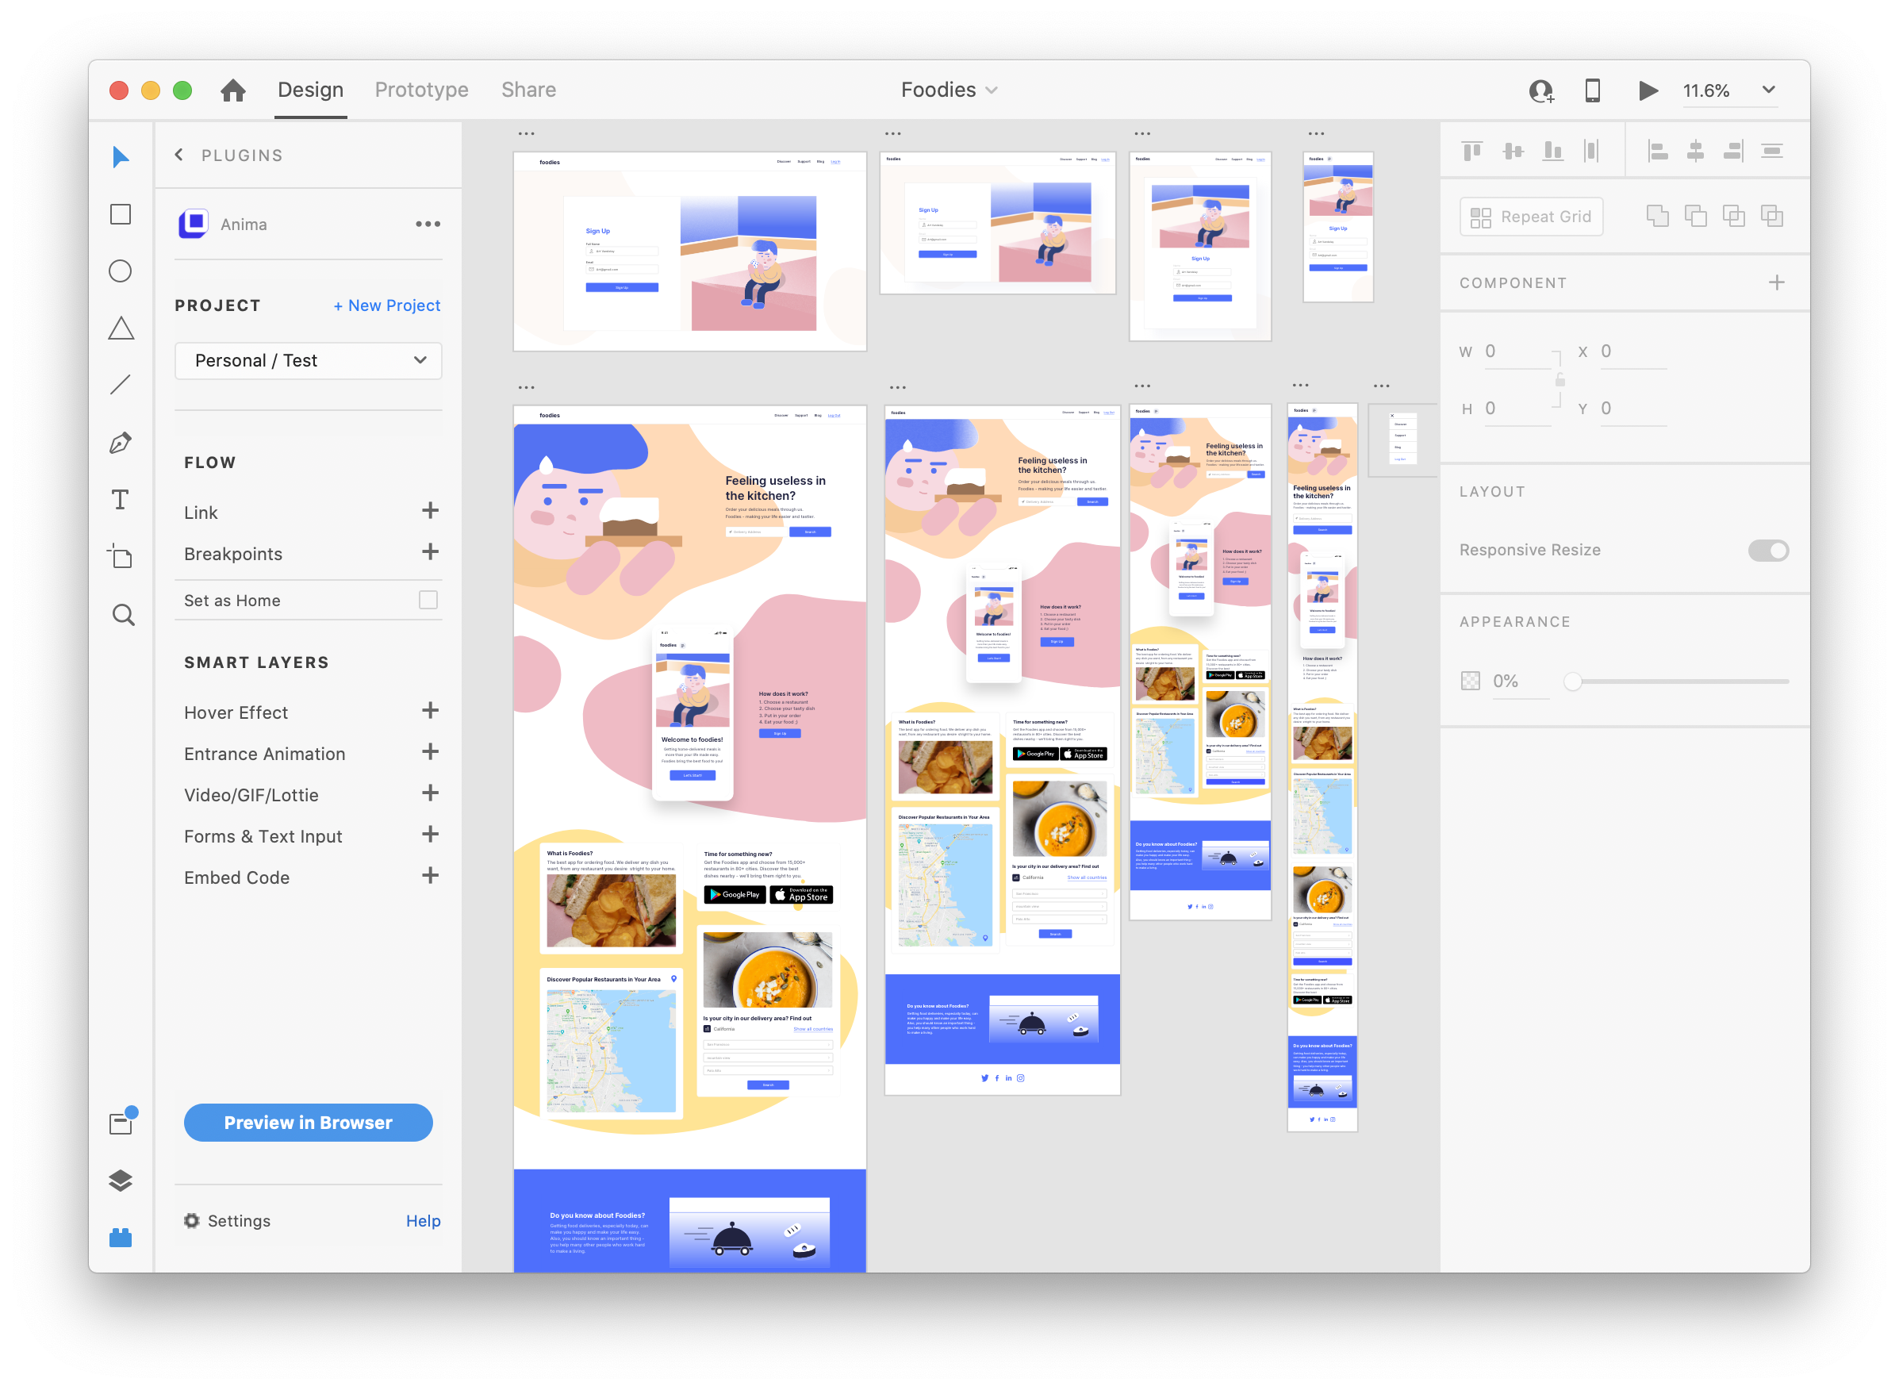
User experience

Slide 8


Mobile Development
Software Development Kit

Slide 9
Software Development Kit
Many Software development kit
One platform
Slow application

Slide 10
Criteria
Native Performance
Open Source
Fast Development

Slide 11


Slide 12

Simple interface design
Data transport and data protection
Case number inputs
Website Security
Officers must use badge number as username to sign into the app
Credential protection
Links to URL
Notes:
On this project, the PD spoke about also wanting a web-based application so I will be working on the front-end
Some regulatory requirements needed for the front-end would be:
Data transport and data protection
There will be information on certain pages that should only be accessible by the victim and/or Officers
Has police officers badge number and victims case number that they will want to be provided
It will also need to be able to safely transport data between the Front-end, Back-end, and Mobile App
There has to be a type of Website Security since websites are becoming more prone to getting “hacked” and hackers obtaining information from the sites that they shouldn’t be able to obtain
Such as credential since officers will have a username and password, so there will need to be protection there
Functionality and design requirements for this:
As the PD said, it has to be simple. They want the UI/UX design to be user friendly so usage for victim and officer would be easy
Has to be easy to navigate through and obtain information for specific needs and cases
Has to have helpful links to URL depending on the type of case the PD are dealing with for the victim to easily and quickly access
Customizable per Police Officer to provide information to their liking

Slide 13
Operational
Requirements
Protected information:CHRI
Database will link to web addresses or documents
Low maintenance
Database security
Data syncing
Application will only be available to the police
Compatible with IOS 14.4 - iPhone SE 2nd Gen
Notes:
Hi everyone, my name is Elina and I will be working on the database development for this project and i am also the team scribe
Now, we will go over the operational Requirements which pertain to data storage and retrieval, interface preferences, and customization
The first requirement will be what information needs to be protected, which is the CHRI this stands Criminal History Record Information, the WPD will be helping us with this by send us a list of servers that are pre-certified and already has this protected such as the apple cloud server
Next, the database will need to access the different PDFs, pamphlets, contact information, etc. that WPD is wanting to be communicated to the citizen or victim
Our project will also need to be low maintenance. Different departments in the WPD need to be able to maintain and update the data such as web addresses, pdfs, or documents as necessary
Another requirement is database security: this links back to to the protected information but is also about making sure that our data is secure from other hazards such as NoSQL Injections. As is often the case in web application security, the best way to prevent NoSQL injection attacks is to avoid using unsanitized user inputs in application code, especially when building database queries.
The next requirement is data syncing. We will be syncing the data on the backend to help keep the phone synced to the web-based program as well as updatable. This will also help keep the data on the phone storage to keep the data offline
After talking with the WPD some other requirements is that the application will only be available to the police and not the public
The last requirement is that it is compatible with the phones the police officers have. the phones that were issued to the officers are the iPhone SE 2nd generation and that have the latest update of IOS 14.4 .

Slide 14
Questions?
Notes:
That is the end of the presentation we have prepared for you all today. Are there any questions?

